Slide 1

SMART CROP PROTECTION SYSTEM FOR AGRICULTURE
BY
DEEPIKA
LOKESHWARI
RATHIPRIYA
SARTHAJ

Slide 2
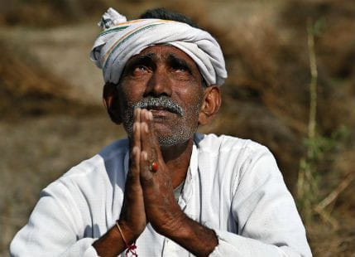
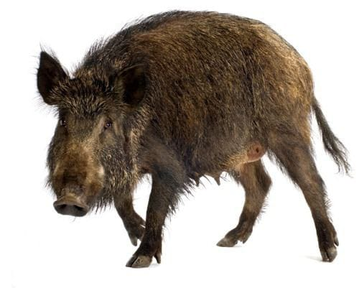

.
PROBLEM
Wildlife attacks on crops, also known as crop vandalism, are becoming increasingly common in Tamilnadu, Himachal Pradesh, Punjab,Haryana,Kerala and other states.
A lack of moisture, or water stress, can cause leaf abscission and a reduction in leaf area and seed production.

Slide 3
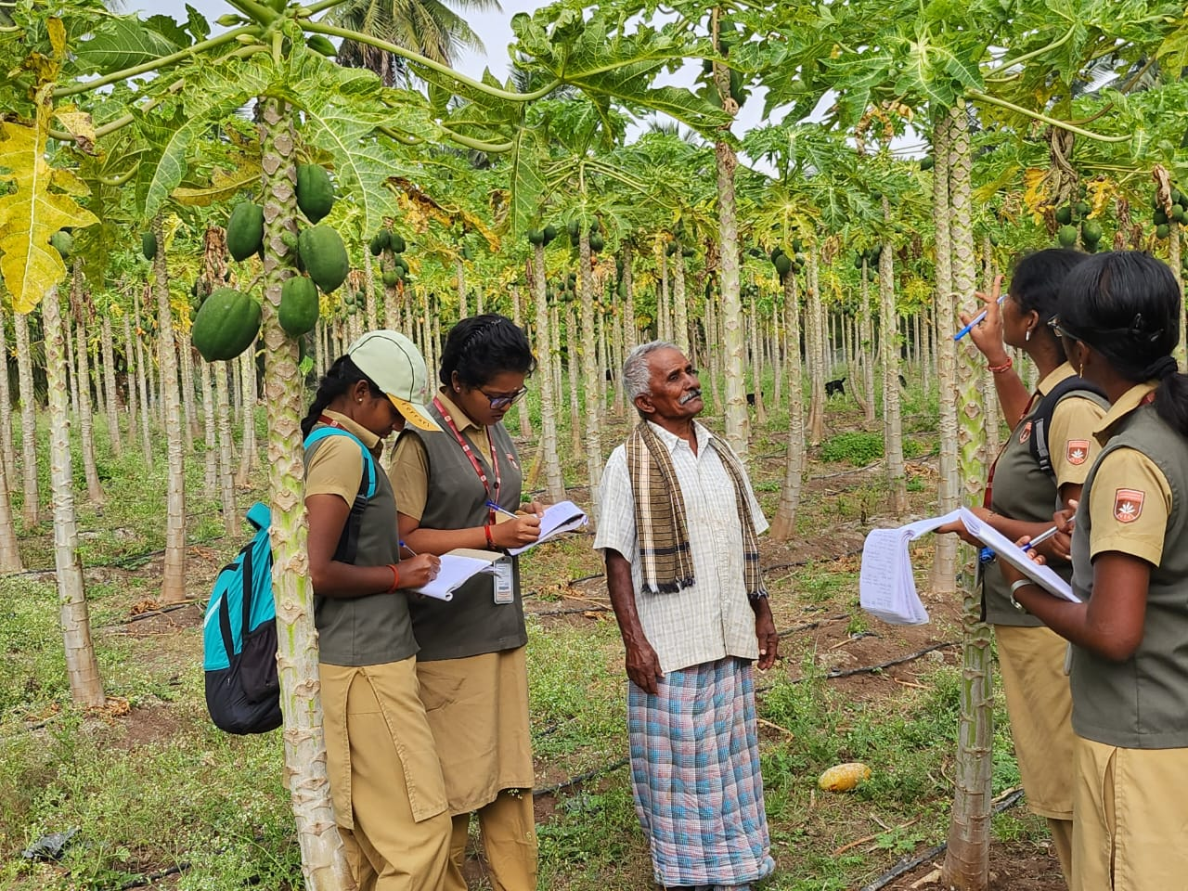
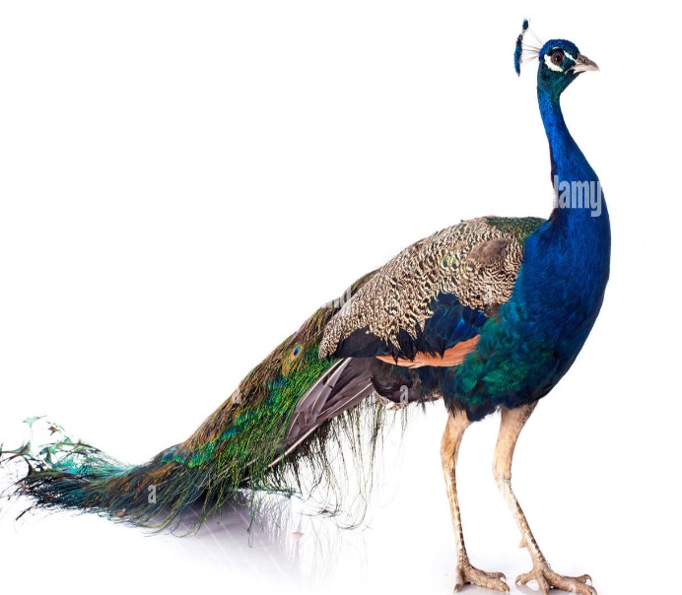
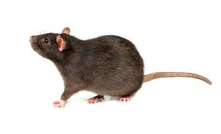
SURVEY-1-06-02-2023
Mr.Dhuraisamy’s field located at Panamarathupatty cultivated around 5 acres

Slide 4
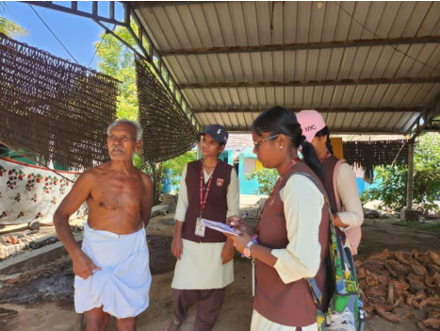

SURVEY-2 06-02-2023
Mr.Perumal’s field located in PANAMATHUPATTY.He has a cultivated land around 3 acres.

Slide 5
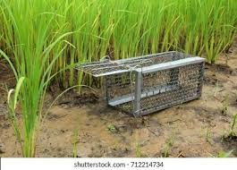
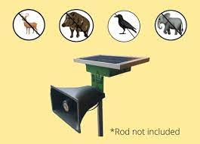
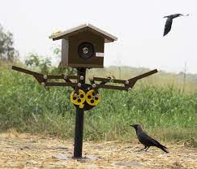

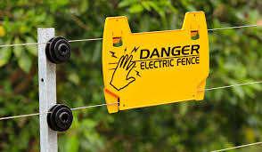
TRAPPING & HUNTING
VISUAL REPELLENTS
SOUND SYSTEM
ELECTRIC FENCING

Slide 6
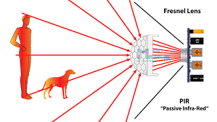

PROPOSED SYSTEM

Slide 7
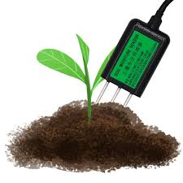

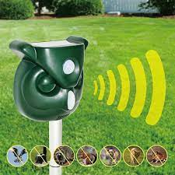

METHODOLOGY

Slide 8
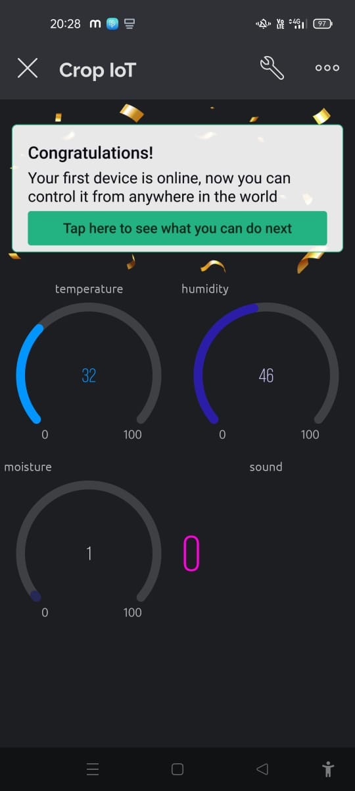
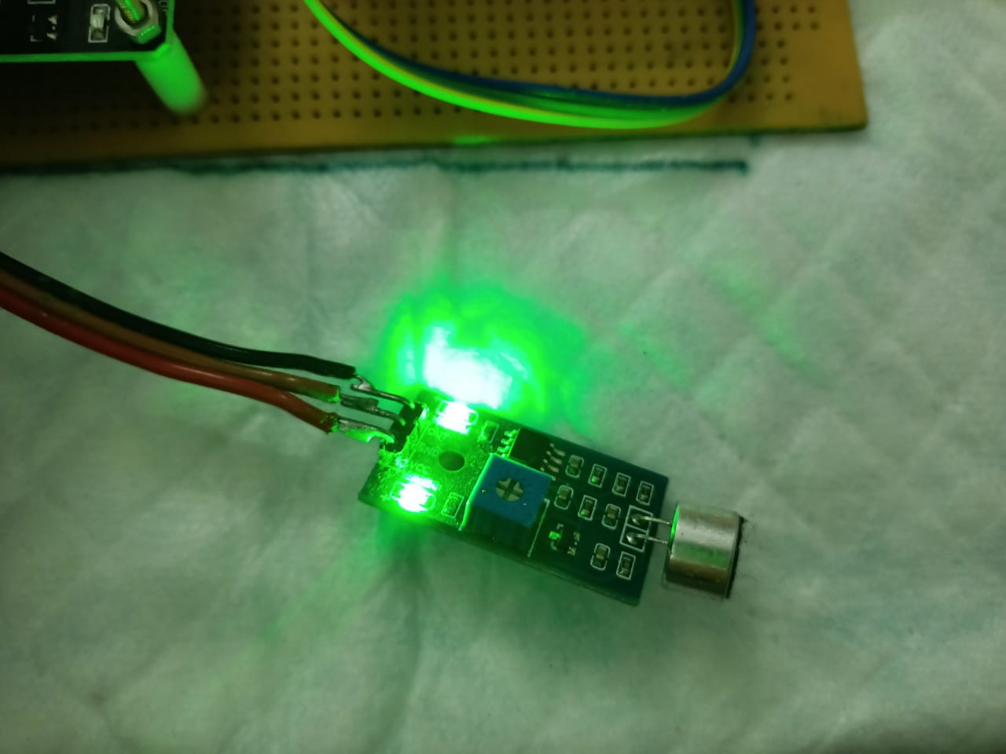
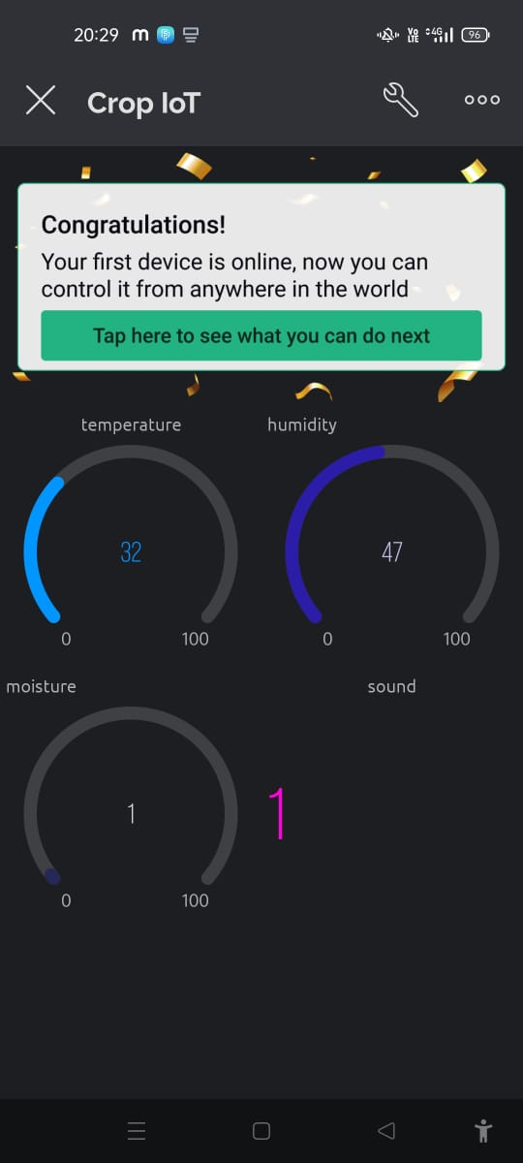
SOUND SENSOR

Slide 9
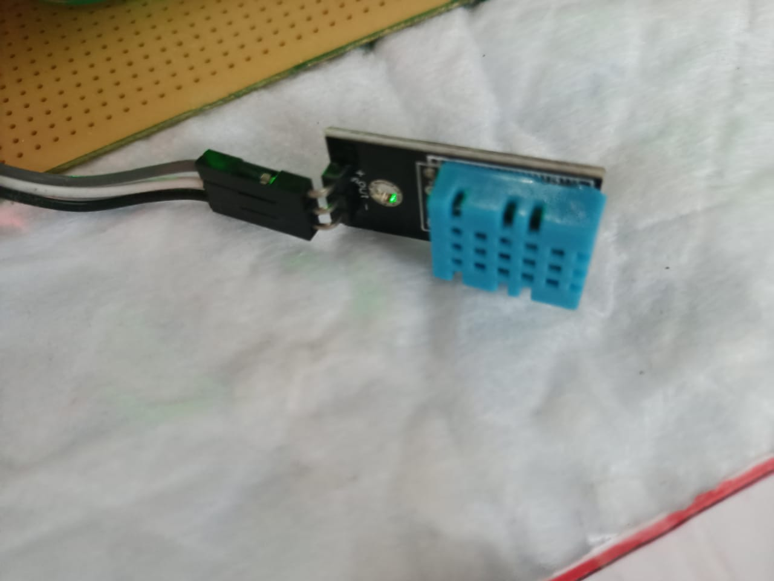

HUMIDITY SENSOR

Slide 10
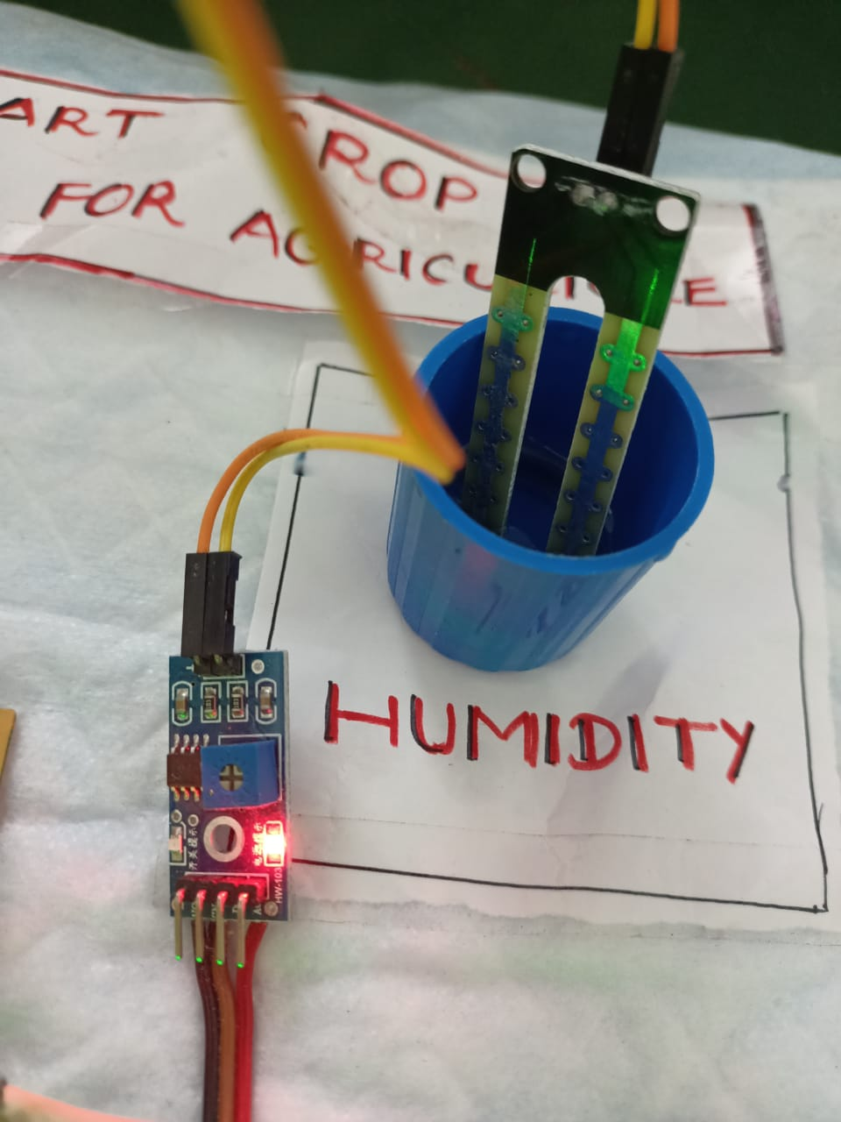
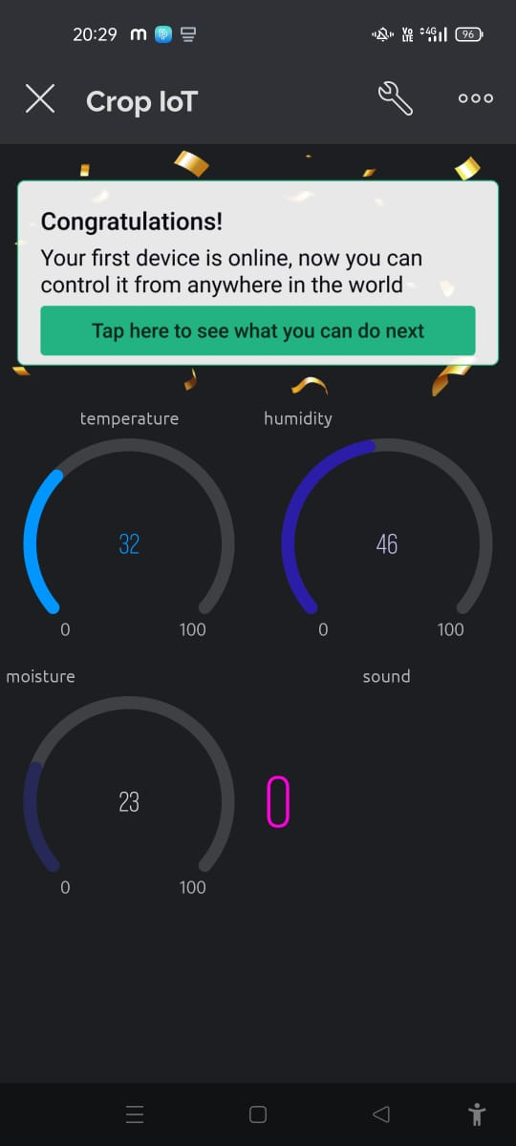
SOIL MOISTURE SENSOR

Slide 11
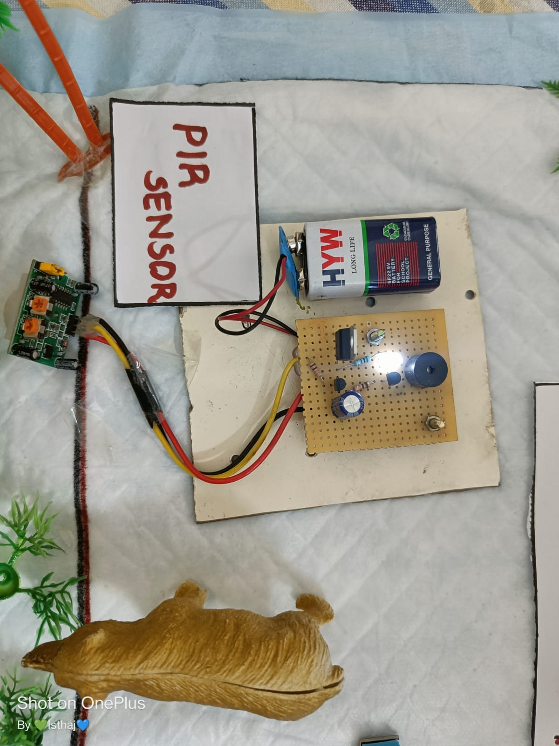
PIR SENSOR

Slide 12
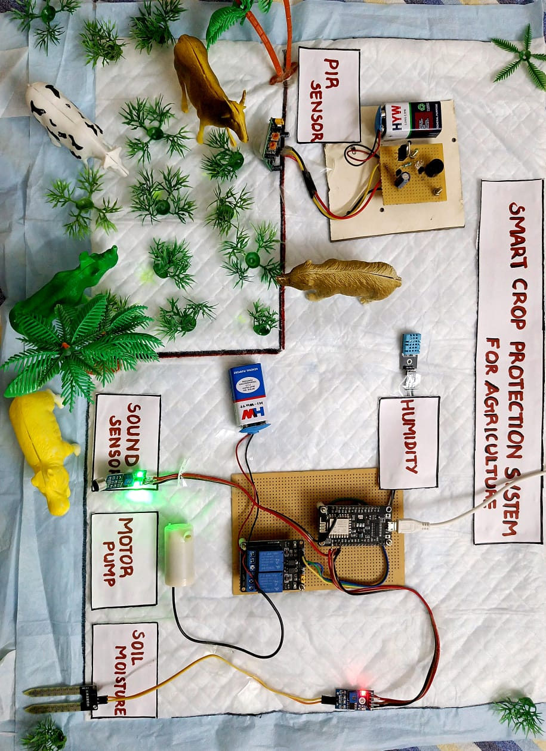
MODULE OUTPUT

Slide 13

CONCLUSION
Major social issue in recent years.
Saves money
Economic wellbeing
Higher crop yields

Slide 14

FUTURE SCOPE
Anywhere and at anytime
Increases crop production
Less labor results in more crops.
More crops result in a healthier life cycle for future generations.

Slide 15


Slide 16
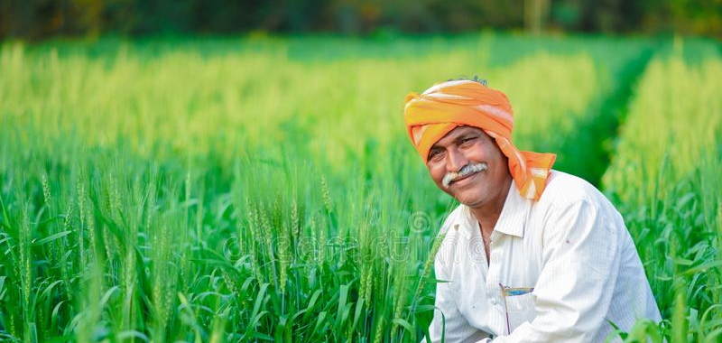

Slide 17
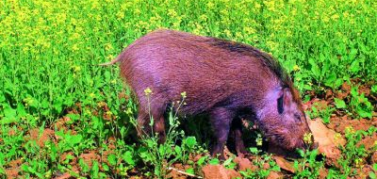

Slide 18
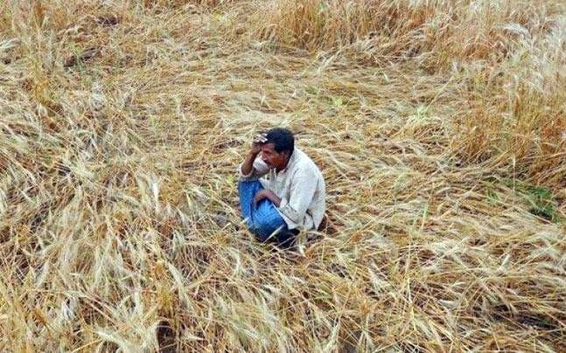

Slide 19
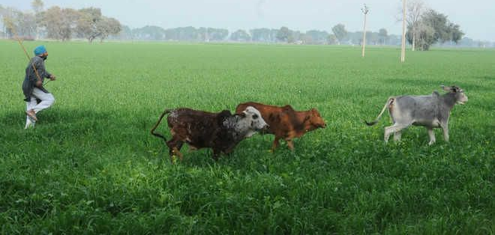

Slide 20
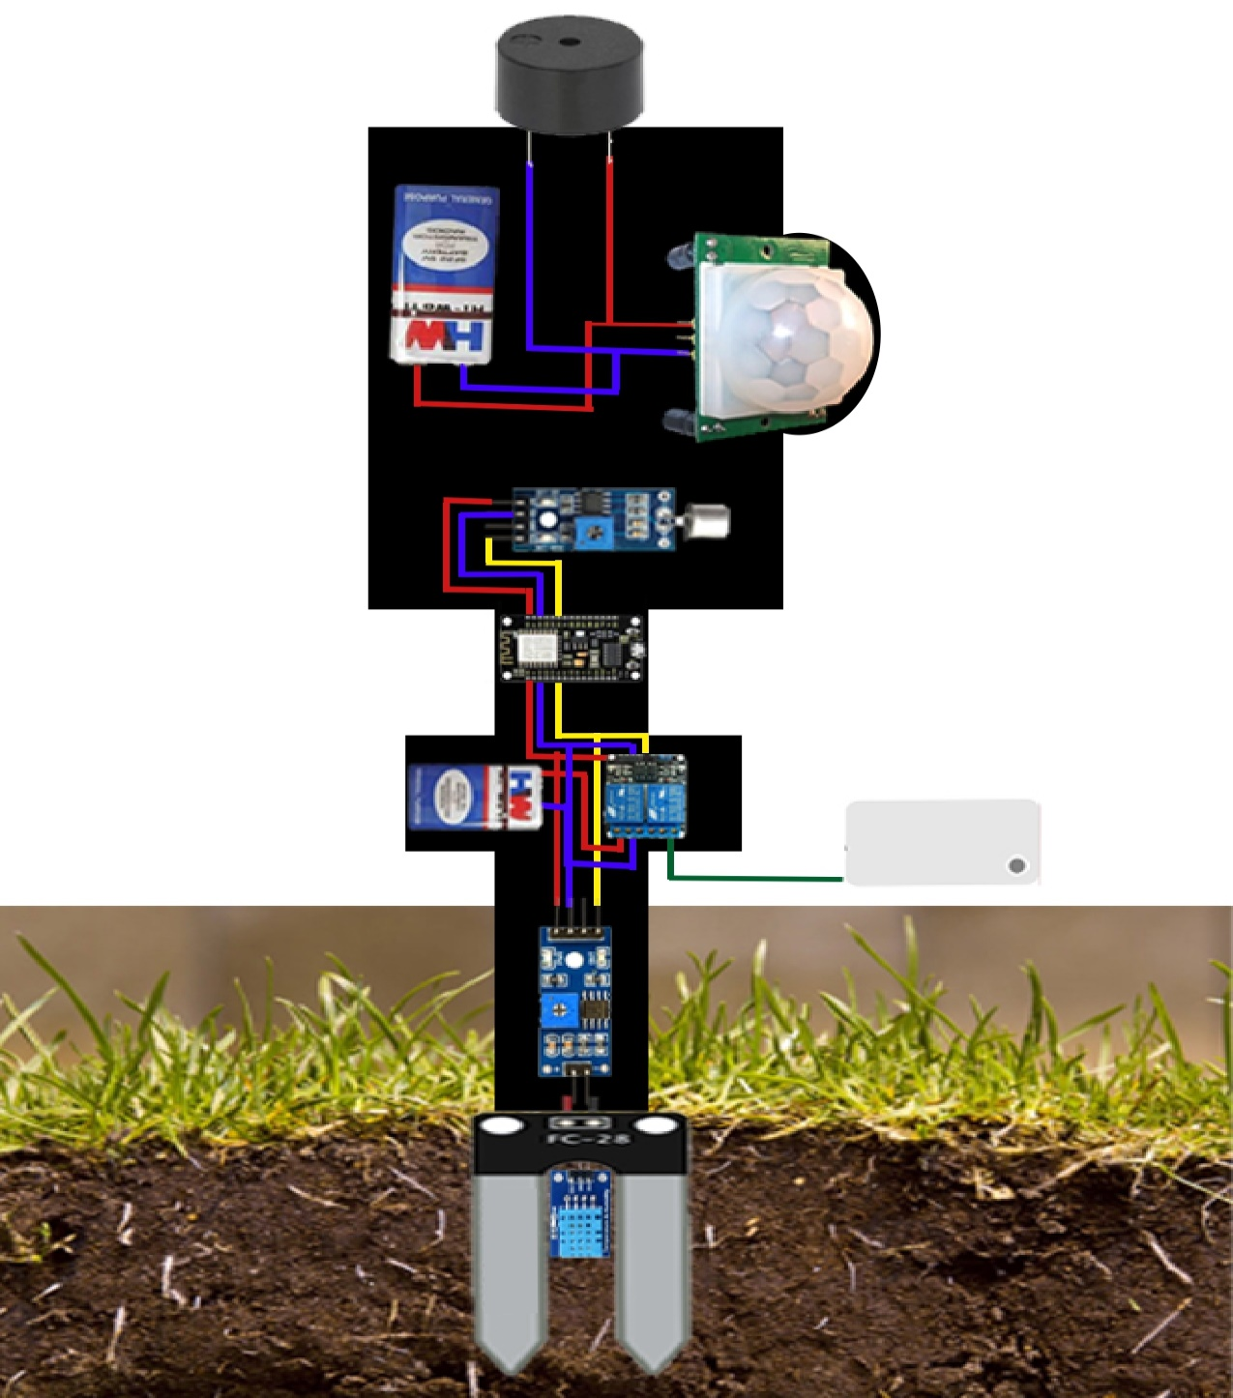

SOLUTION
BUZZER ALARM
HI VOLT BATTERY
PIR SENSOR
SOUND SENSOR
ESP8266
2V RELAY
MOTOR PUMP
DHT11
SOIL MOISTURE SENSOR

Slide 21
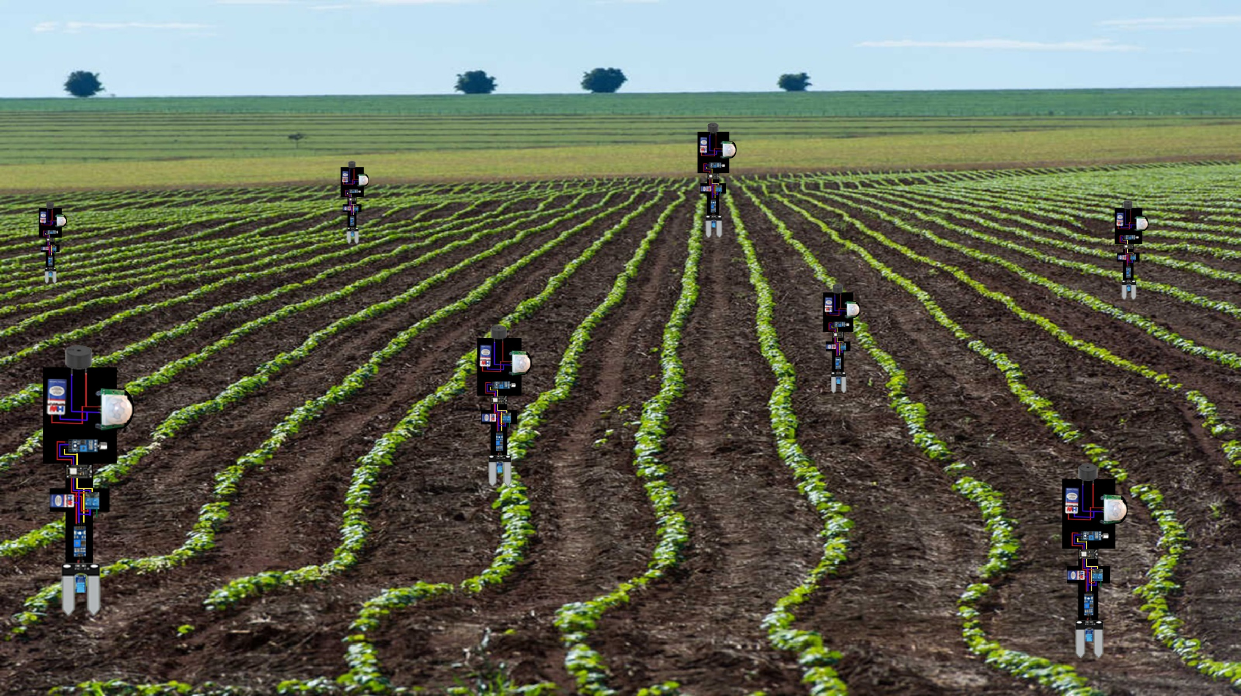

Slide 22
